Slide 1
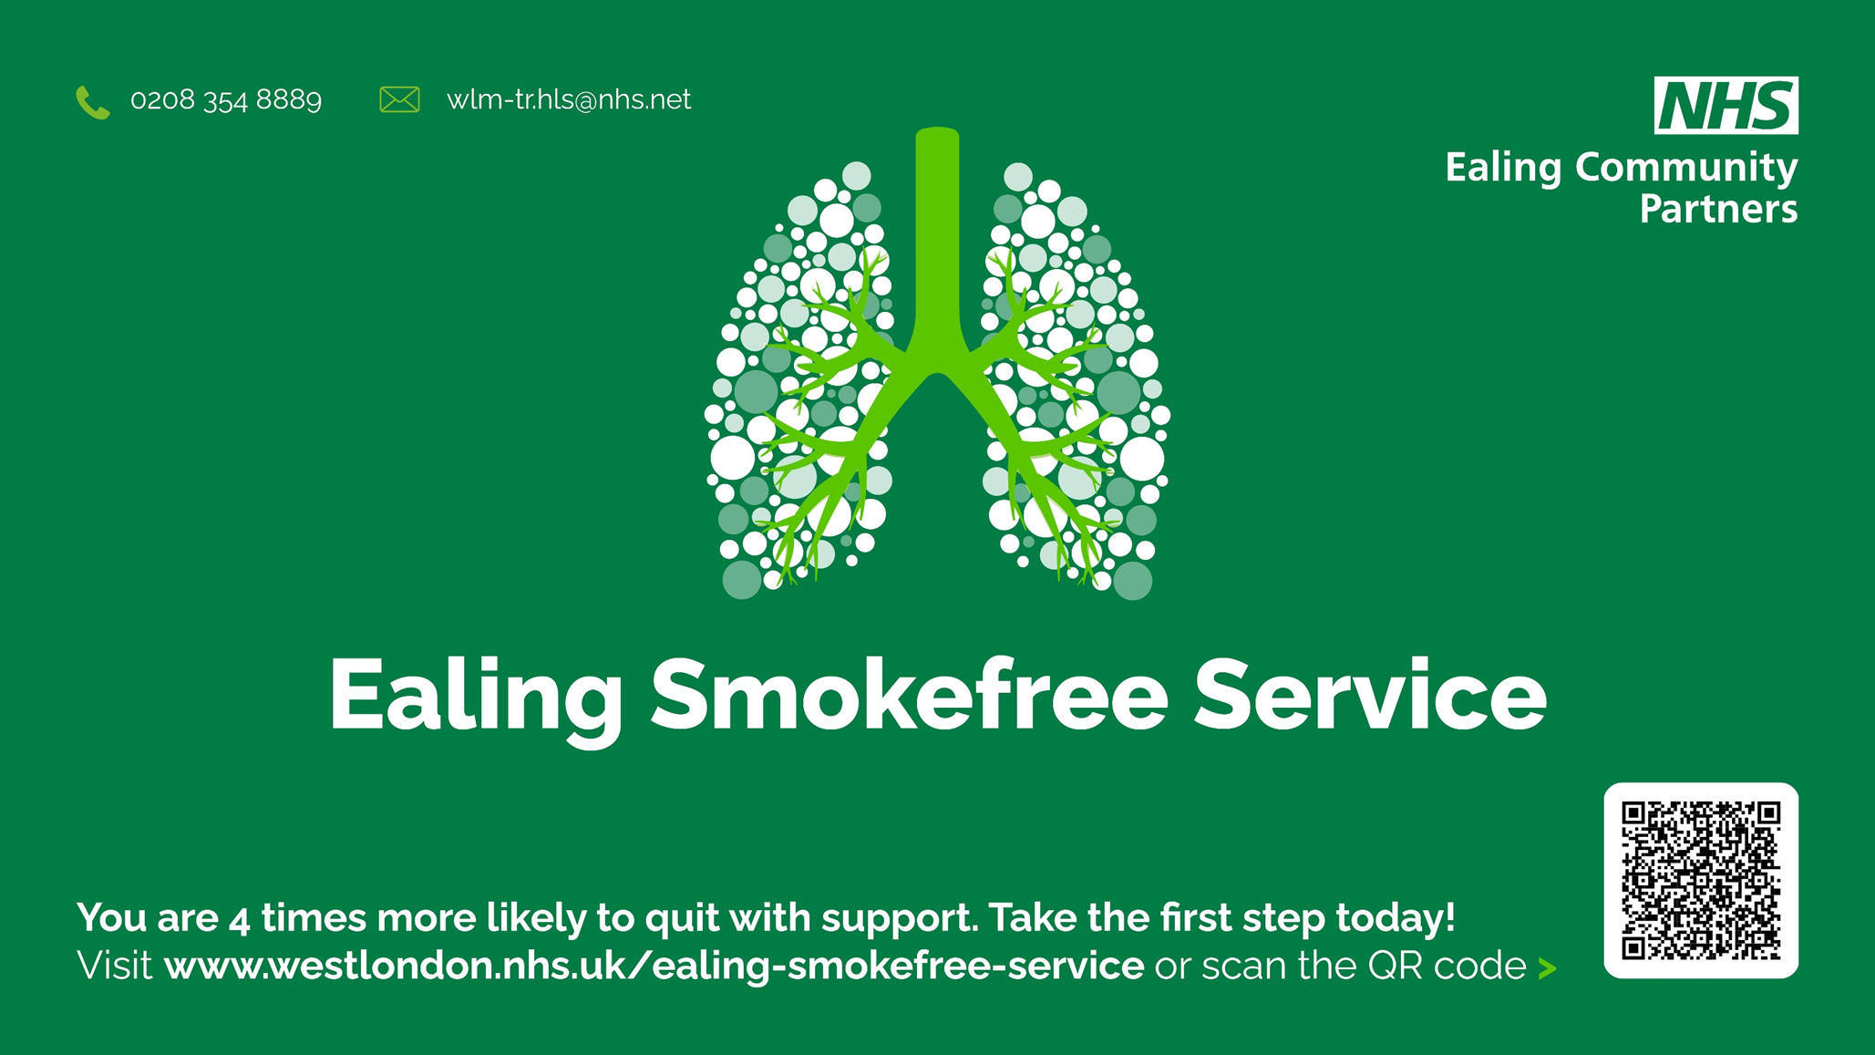
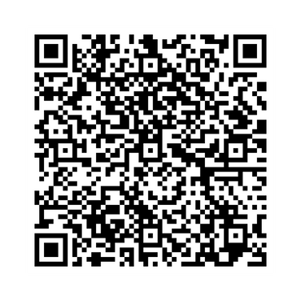

You are 4 times more likely to quit with support today!
Scan the QR code for a referral

